Slide 1
Prediction of COVID-19 Using Machine Learning Classification Algorithms
Research/Project Presentation
by
Name: Rakshit Ajay
Department of Computer Science & Engineering
Manipal Institute of Technology, Manipal
Under the supervision of
Dr. Shafeeq Ahmed
Professor, Dept. of Computer Science and Engineering
Manipal Institute of Technology, Manipal

Slide 2
Presentation overview
Introduction
Literature Review
Research Gaps Identified
Problem Definition
Objectives
Methodology
Result Analysis
Conclusion
Future Scope
Journal/Conference
References

Slide 3
Introduction: What is COVID - 19?
COVID-19 is a contagious disease caused by the SARS-CoV-2 virus, first identified in Wuhan, China in December 2019, but evidence indicates it may have spread earlier in places like Italy.
COVID-19 symptoms range from fever, cough, and fatigue to severe complications like ARDS(Acute Respiratory Distress Syndrome ), caused by cytokine storms and multi-organ failure. Symptoms appear 1-14 days post-exposure, with potential long-term organ damage, especially to the lungs and heart.

Slide 4
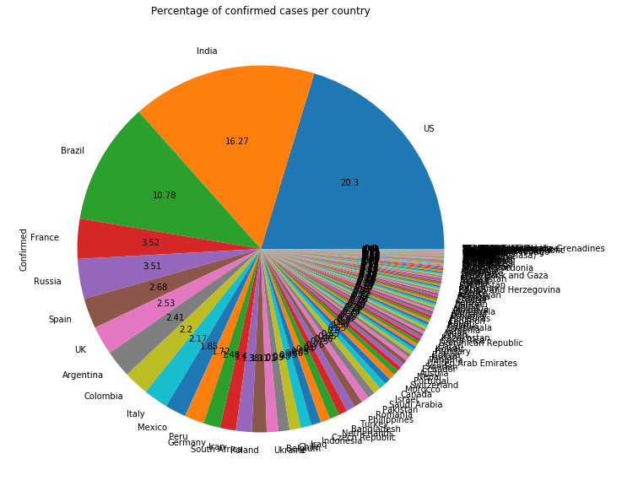
Research Topic – Global view
As per the data analysis, Covid-19 virus has spread out all over the world and affected 246 countries. Among the 246 countries the Top 5 countries those are affected vastly are,
United States of America (20.3%) of the world’s statistics. Second worst condition is of India, holding the share of 16.27% and the third one is Brazil, holding the 10.78% share of the world’s total confirmed cases tally. After that France and Russia showing their share percentage of 3.52 and 3.51 respectively.
Fig1. Percentage of confirmed cased per country

Slide 5
Motivation
Understanding the Spread: Data analysis helps in understanding how the virus spreads through populations, which is essential for implementing effective public health measures.
Resource Allocation: It helps in allocating resources like medical supplies, hospital beds, and personnel in areas where they are most needed.
Forecasting and Prediction: By analyzing trends and patterns, epidemiologists and public health officials can make informed predictions about the future course of the pandemic, allowing for better planning.
Early Detection: Machine learning models can help in the early detection of outbreaks or spikes in COVID-19 cases, enabling quicker responses and containment efforts. This can potentially save lives and reduce the strain on healthcare systems.

Slide 6
Literature Review – I
Author & Year | Title | Work done | Observations
Iweendi, C., Mahboob, K., Fergus, P., & Harkin, J. (2020) | "Machine Learning Model Utilizing Random Forest Algorithm for COVID-19 Patient Outcome Prediction” | Algorithmic Enhancement Prediction Target Data Utilization Performance Evaluation Integration of Machine Learning Techniques Application in Healthcare | Algorithmic Optimization Comprehensive Data Integration Real-world Application Performance Evaluation Ensemble Learning Potential for Further Research

Slide 7
Literature Review – II
Author & Year | Title | Work done | Observations
Algani et al. (2022) | "Overview of Classification Models for Predicting COVID-19 Cases Using Demographic and Environmental Factors" | Dataset Description Classification Model Exploration Feature Engineering Model Evaluation | Multifactorial Analysis Incorporation of Categorical Parameters Machine Learning Application Practical Implications

Slide 8
Literature Review – III
Author & Year | Title | Work done | Observations
Sarwar et al. (2020) | "Prognosis of Diabetes Using Machine Learning Techniques" | Diabetes Prognosis Machine Learning Techniques Ensemble Technique Application to COVID-19 Prognosis | High Accuracy Transferability to COVID-19 Prognosis Multimodal Data Integration Impact on Public Health

Slide 9
Literature Review – IV
Author & Year | Title | Work done | Observations
Tschoellitsch et al. (2021) | "Model Development for Prognosis of COVID-19 Using Random Forest Algorithm Based on Routine Blood Tests" | Model Development Algorithm Selection Performance Metrics Important features | Utilization of Routine Blood Tests Algorithmic Approach Performance Evaluation Identification of Important Features

Slide 10
Literature Review – V
Author & Year | Title | Work done | Observations
Bayat et al. (2021) | "Predictive Modeling of COVID-19 Based on Standard Laboratory Tests: Utilizing XGBoost Algorithm with Analysis of Top 10 Features" | Model Development for COVID-19 Forecasting Algorithm Selection Performance Metrics Identification of Important Features | Large Dataset Utilization High Performance Metrics Relevance for Healthcare Decision-Making Feature Importance Analysis

Slide 11
Research Gap
COVID-19 outbreak prediction datasets are complex, making it difficult to establish relationships between features.
Past research lacks outlier removal methods, which are crucial for improving prediction efficiency.
Pre-processing should include standard methods like under-sampling or oversampling to clean the dataset and enhance prediction analysis efficiency.

Slide 12
Problem definition
Development of a user-friendly ML algorithm for COVID-19 outcome prediction, optimizing patient care and aiding global pandemic management. Leveraging advanced techniques, it addresses urgent healthcare needs, enhancing COVID-19 response efforts worldwide.

Slide 13
Research Objective
The objective is to develop a machine learning algorithm capable of predicting the category of COVID-19 disease in patients based on various clinical features and diagnostic parameters. By implementing this algorithm, healthcare professionals can efficiently categorize patients into different severity categories, enabling timely and targeted interventions.

Slide 14
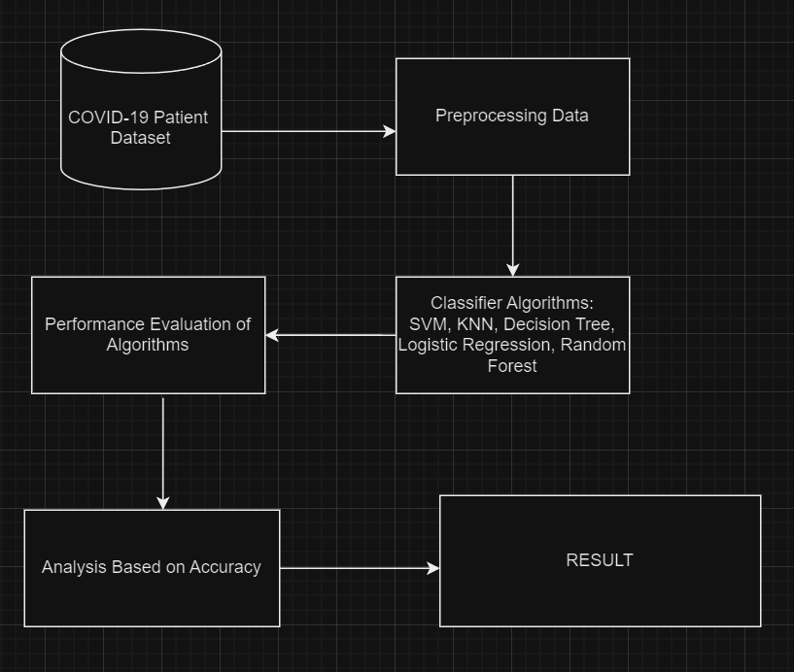
Methodology
Fig2. Proposed framework

Slide 15
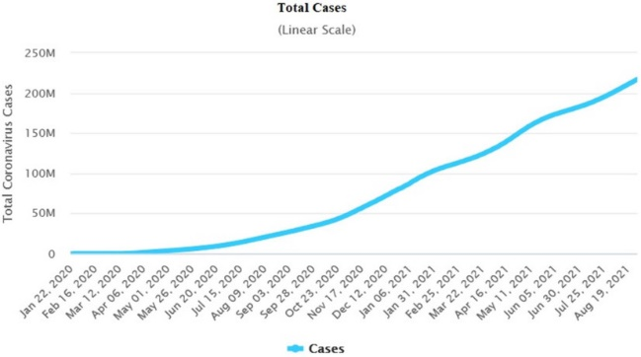
Dataset Statistics
Fig3. Linear Graph of Total cases

Slide 16
Dataset
1. S.No. (Serial Number): Provides a unique identifier for individual patient records, aiding in their organization and reference.
2. Patients Identifier or Id: Assigns alphanumeric identifiers to patients, facilitating efficient data management and retrieval.
3. Age: Records the age of patients, a critical demographic variable influencing COVID-19 susceptibility and severity.
4. Body Temperature: Captures the body temperature of patients, serving as an early indicator of potential COVID-19 infection due to fever.
5. Fatigue: Indicates whether patients experience fatigue, a common symptom of COVID-19 that can significantly impact daily life.
6. Cough: Identifies whether patients exhibit coughing, a hallmark symptom of COVID-19 often accompanied by respiratory issues.
7. Body Pain: Records whether patients experience body pain or muscle aches, common symptoms of viral infections including COVID-19.
8. Sore Throat: Indicates whether patients present with a sore throat, a symptom reported by some individuals with COVID-19.
9. Breathing Difficulty: Identifies patients experiencing difficulty breathing or shortness of breath, indicating potential severe respiratory involvement.
10. Infected: Categorizes patients based on COVID-19 infection status, serving as the target variable for predictive modeling tasks aiming to predict infection status based on other features.

Slide 17
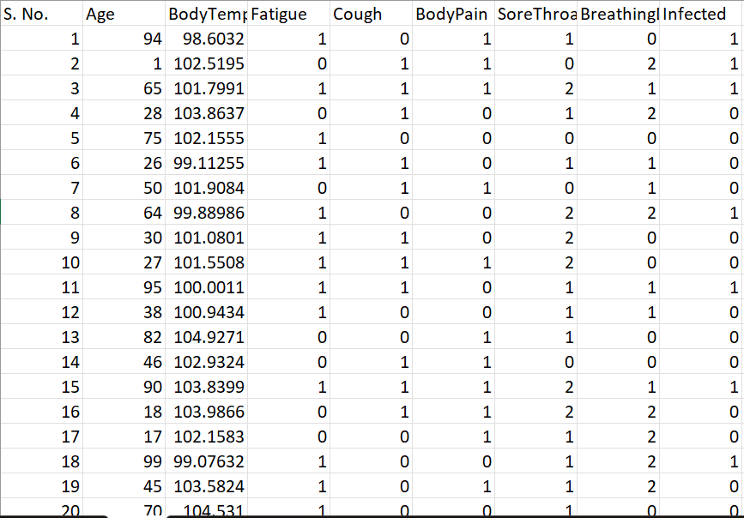
Dataset

Slide 18
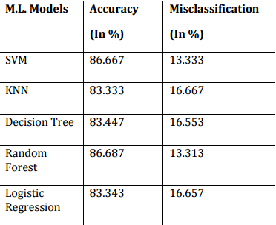
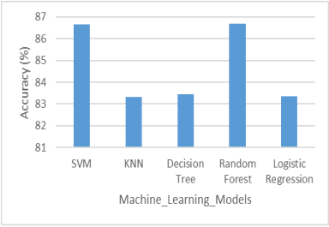
Result Analysis
Fig4. Result Description
Fig5. Bar Graph on Result Description

Slide 19
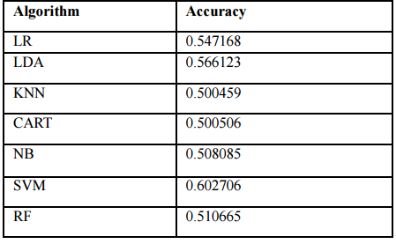
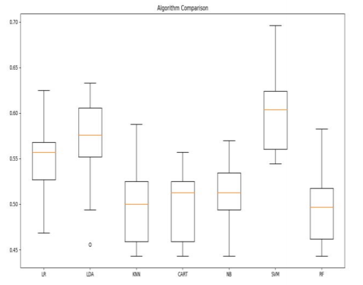
Result Analysis
Fig6. Accuracy of Algorithms
Fig7. Box-and-whisker plot Algorithm Comparison

Slide 20
Conclusion
In our COVID-19 prediction study, Random Forest led with an 87% accuracy rate among five machine learning algorithms. Moving forward, we acknowledge the necessity of incorporating more classifiers to refine the evolving COVID-19 dataset.
During the study, Stochastic Gradient Descent achieved 99% accuracy in 0.01 seconds, making it the top choice for COVID-19 case prediction and offering valuable insights for pandemic management.

Slide 21
Future Scope
Machine learning in healthcare streamlines disease prediction, diagnosis, and treatment, improving overall efficiency. By analyzing historical and real-time data, it aids in swift decision-making for patient care, enhancing research and clinical trials.
Future scope for predicting COVID-19 using machine learning includes refining models for accuracy, integrating diverse datasets, leveraging AI advancements, and deploying real-time predictive models for proactive public health interventions and resource allocation.

Slide 22
Journal/Conference
NBBC (National Conference on Biotechnology and BioMedicines)
NCMHS (National Conference on Medical and Health Sciences)
ICHM (International Conference on Medical and Health Sciences)
Nature (Science Journal)
Athens Journal of Health and Medical Sciences
WCMSR (World Conference of Medical Student Research)

Slide 23
References - I
[1] Patel, D., Kher, V., Desai, B., Lei, X., Cen, S., Nanda, N., ... & Oberai, A. A. (2021). Machine learning based predictors for COVID-19 disease severity. Scientific Reports, 11(1), 4673.
[2] Jathanna, S. V. (2021). Prediction of COVID-19 Using Machine Learning Classification Algorithms. International Research Journal of Engineering and Technology (IRJET), 2395-0056.
[3] Majumder, A. B., Gupta, S., Singh, D., & Majumder, S. (2021, February). An intelligent system for prediction of COVID-19 case using machine learning framework-logistic regression. In Journal of Physics: Conference Series (Vol. 1797, No. 1, p. 012011). IOP Publishing.
[4] Ogundokun, R. O., & Awotunde, J. B. (2020). Machine learning prediction for covid 19 pandemic in india. medRxiv, 2020-05.
[5] Mukri, V. M. COVID-19 PREDICTION USING MACHINE LEARNING.
[6] Malhotra, D. (2022). DESIGN AND IMPLEMENTATION OF COVID 19 PREDICTION BY USING MACHINE LEARNING MODEL.

Slide 24
References - II
[7] Katz, R., Toole, K., Robertson, H., Case, A., Kerr, J., Robinson-Marshall, S., ... & Graeden, E. (2023). Open data for COVID-19 policy analysis and mapping. Scientific Data, 10(1), 491.
[8] Paul, S. G., Saha, A., Biswas, A. A., Zulfiker, M. S., Arefin, M. S., Rahman, M. M., & Reza, A. W. (2023). Combating Covid-19 using machine learning and deep learning: Applications, challenges, and future perspectives. Array, 17, 100271.
[9] Pandey, K., & Panchal, R. (2020). A study of real world data visualization of COVID-19 dataset using Python. International Journal of Management and Humanities (IJMH), 4(8), 1-4.
[10] Santos, B. S., Silva, I., da Câmara Ribeiro-Dantas, M., Alves, G., Endo, P. T., & Lima, L. (2020). COVID-19: A scholarly production dataset report for research analysis. Data in Brief, 32, 106178.
[11] Mondal, M. R. H., Bharati, S., & Podder, P. (2021). Diagnosis of COVID-19 using machine learning and deep learning: a review. Current Medical Imaging, 17(12), 1403-1418.

Slide 25
References - III
[12] Meraihi, Y., Gabis, A. B., Mirjalili, S., Ramdane-Cherif, A., & Alsaadi, F. E. (2022). Machine learning-based research for COVID-19 detection, diagnosis, and prediction: a survey. SN computer science, 3(4), 286.
[13] Atiyah, O. S., & Thalij, S. H. (2022). Evaluation of COVID-19 Cases based on Classification Algorithms in Machine Learning. Webology, 19(1), 4878-4887.
[14] Jafar Zaidi, S. A., Chatterjee, I., & Brahim Belhaouari, S. (2022). COVID-19 tweets classification during lockdown period using machine learning classifiers. Applied Computational Intelligence and Soft Computing, 2022, 1-8.
[15] Kwekha-Rashid, A. S., Abduljabbar, H. N., & Alhayani, B. (2023). Coronavirus disease (COVID-19) cases analysis using machine-learning applications. Applied Nanoscience, 13(3), 2013-2025.

Slide 26
Thank You ☺

